Slide 1




COF Dining at Wentworth
Appetites Are Welcome!

Slide 2


What’s Going on at Wentworth?
All-You-Care-To-Eat @ Beatty Dining Commons!
Green-To-Go for those on the move!
A Dining Program with options suited to meet student’s needs!

Slide 3

Dining Terminology at WIT
AYCTE: “All You Care To Eat”
MEAL SWIPES: Credits that represent one meal / entry to the AYCTE facility also known as BLOCK MEALS. These have value at all locations.
DINING POINTS: Credits that can be used be used at all COF dining facilities also known as DECLINING BALANCE
MEAL EQUIVALENTS: Meal swipes can have value at non-AYCTE locations (the value of a swipe may vary by location)

Slide 4

BEATTY DINING COMMONS:
All-You-Care-To-Eat (AYCTE)
Beatty Dining Commons at Wentworth Institute of Technology is the focus of AYCTE.
How Does It Work? It’s Easy!
Your Dining Plan gives you access; come on in and eat what you want. When you’re hungry again, come back and repeat!
Each Meal swipe allows you to enter the facility for one meal period (Breakfast, Lunch and Dinner).

Slide 5


Dunkin’ @ WIT…
For those Leopards on the go, we are partnering with Dunkin’ to create an on-campus location at the former Leopard’s Café. Please follow campus announcements for more information and updates!

Slide 6

WIT Dining Plans:
Residential Full Plans:
PLATINUM, GOLD, SILVER
Residential Partial Plans:
DIAMOND, RUBY, EMERALD,
Non-Residential Plans:
HUNTINGTON, RUGGLES, PARKER
Summer Plans:
Summer A, Summer B, Summer C, Summer D
PLEASE NOTE: Meal Swipes expire and renew each semester, Dining Points rollover from Fall to Spring semester and expire at the end of the Spring semester.

Slide 7

WIT Dining Plans:
Unlimited
Unlimited Plan: PLATINUM
This Plan allows for unlimited access to AYCTE locations and 155 Dining Points (spending power in retail locations).

Slide 8

WIT Dining Plans: Residential Full Plans
All Full Plans offer a set Meal Swipes for AYCTE locations and points for retail locations.
GOLD: 225 Meal Swipes & 520 Dining Points
SILVER: 175 Meal Swipes & 730 Dining Points

Slide 9

WIT Dining Plans: Residential Partial Plans
Partial Plans can be used in both AYCTE and retail locations, but we recommend them for students who live in on-campus apartments or commute.
DIAMOND: 1,600 Dining Points
RUBY: 1,195 Dining Points
EMERALD: 600 Dining Points

Slide 10

WIT Dining Plans: Non-Residential Plans
These Plans can be used in both AYCTE and retail locations, but we recommend them for students who live in off-campus apartments or commute.
HUNTINGTON: 55 Anytime Meal Swipes + 105.00 DP
RUGGLES: 30 Anytime Meal Swipes + 55.00 DP
PARKER: 10 Anytime Meal Swipes + 80.00 DP

Slide 11

Dining Plan Requirements
Students living at Evans Way, Tudbury Hall, or Baker Hall and all First-Year Students can choose from:
Platinum Plan
Gold Plan
Silver Plan

Slide 12

Dining Plan Requirements (Cont’d)
Students living in other on-campus housing can choose from:
Platinum Plan
Gold Plan
Silver Plan
Diamond Plan
Ruby Plan
Emerald Plan

Slide 13

Dining Plans:
Door Prices at Beatty Dining Commons
CASH / CREDIT / DEBIT AT DOOR
Breakfast: $11.76
Lunch: $15.22
Dinner: $18.90
DINING POINTS
Breakfast: 10.15 Points
Lunch: 13.50 Points
Dinner: 16.85 Points
*Prices are subject to change;
PLEASE NOTE: Students with Unlimited Access or available Meal Swipes will not need to use Dining Points to gain access.

Slide 14
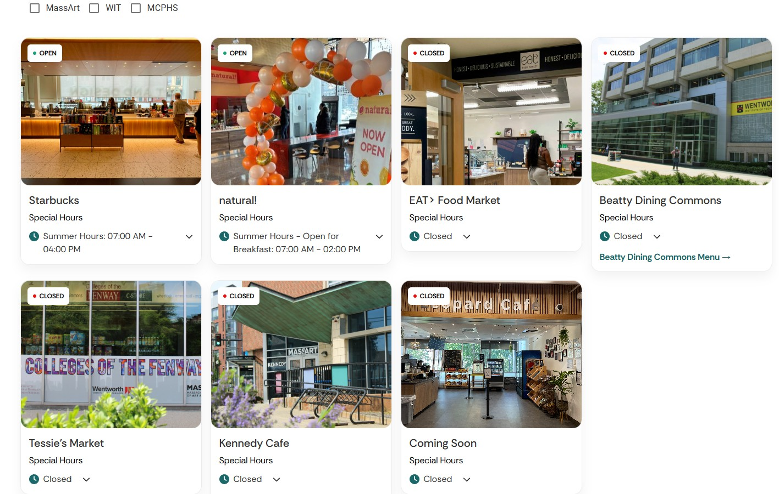
COF Dining Locations

